Slide 1
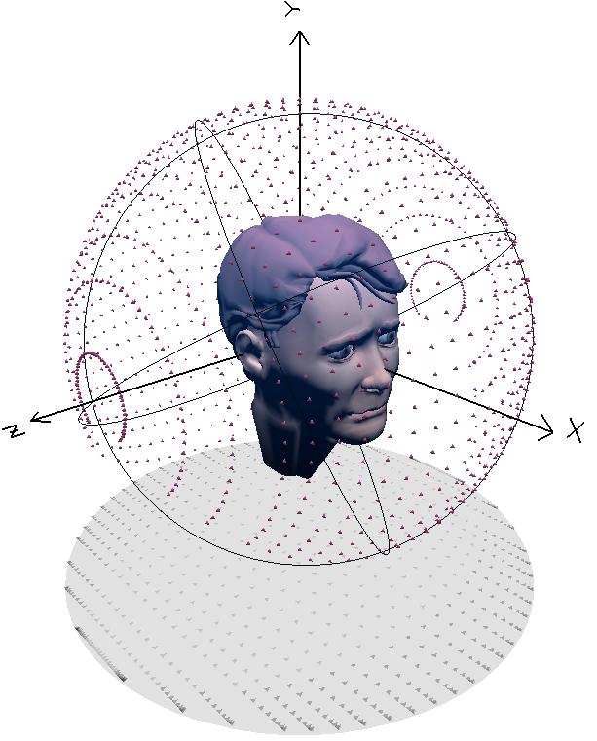
Spatial Audio
Part 3 – Binaural sound

Slide 2
Precedence effect
Sounds from different locations arrive at ears at different times
Step toward one speaker→ monophonic source will appear localised to that speaker
Effect persists despite changes in volume between speakers!
Psychoacoustic phenomenon: precedence effect
Spatial processing inhibited for tens of milliseconds after localised acoustic event
Exploit this by inserting delay in an audio channel

Slide 3
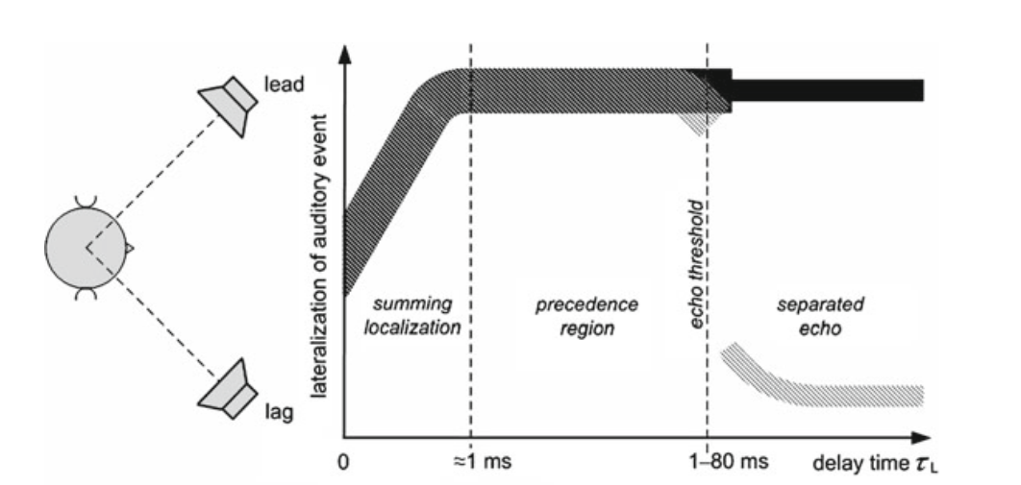
Precedence effect

Slide 4
Gain and delay
Two primary tools for placing sounds in space
> 1ms or > 30dB: sound localised to one source
Two simultaneous sounds
with level difference
Two equal amplitude sounds
with time difference

Slide 5
Gain and delay
Joint control of panorama and precedence effects
Use variable-length delay lines
y_{L}[n]
g_{L}(θ)
Delay_{L}(θ)
x[n]
θ
y_{R}[n]
g_{R}(θ)
Delay_{R}(θ)

Slide 6
Panning & Precedence Implementation
Sources placed in apparent location using
delay
amplitude
Sound from just one side
1 ms delay
>30dB amplitude difference between 2 equally spaced speakers
Source appear half way between center & speaker
0.2ms delay between right & left speaker
Approximately 6dB amplitude difference between right & left channels

Slide 7
Transparent amplification
How to reinforce live sound?
Example: amplifying acoustic instruments on stage
Want apparent sound sources to merge nicely, acoustically and visually, with sounds from acoustic instruments on stage
Possible solution: only front loudspeakers
Sound is not uniform throughout space
Better solution: transparent amplification
Feed rear speakers with delayed signal
Ensures localisation to stage as long as live stage sound always arrives first
Minimum delay depends on distance from stage
Minimum delay for room length L, speed of sound c
T_{D}=L/c (sec)

Slide 8
Head-related transfer function
Panning and precedence give azimuth cues
Based on Interaural Time Difference (ITD) and Interaural Level Difference (ILD)
What about elevation?
How do we localise sound front-to-back?
Head-Related Transfer Function (HRTF)
Torso, head and outer-ear perform elevation-dependent filtering of sounds before they reach inner ear
Filtering effects resolve ambiguity in ITD and ILD
Filtering can be artificially simulated

Slide 9
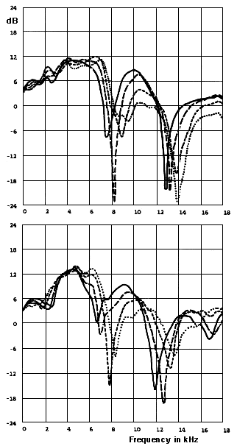
HRTFs
HRTFs are unique
But patterns emerge
HRTFs for 2 subjects
Sound 2 meters to left of subject
moved from ear level (0 degrees) to elevation 30 degrees above
solid line: 0 degrees
long dashes: 10 degrees
short dashes: 20 degrees
dotted line: 30 degrees

Slide 10
Head shadowing
Head shadowing = sound travelling through or around head to reach inner ear
Head can produce significant attenuation
Also filtering effect, usually lowpass filter
Model: diffraction of plane wave around rigid sphere
Head shadowing can cause perception problems with linear distance and direction

Slide 11
Head Shadowing and ITD
a – effective radius of head
θ – azimuth
α – position of the zero
HRTF
ITD – modelled as first order allpass filter

Slide 12
Sound wave from distant source acts like plane wave, approaches spherical head of radius r from azimuth angle θ.
rsinθ
plane
wave
Path length difference d=rsinθ+rθ
Time difference T_{d}=d/c, c is speed of sound
Typical adult head r=0.14/2 m
θ=45º, T_{d}=(0.07/343)(π/4+sin(π/4))=301µs
(300µs measured)
θ=90º, T_{d}=(0.07/343)(π/2+sin(π/2)) = 524µs
(400µs measured)
If head size changed to 18cm diameter,
θ=90º, T_{d}=(0.09/343)(π/2+sin(π/2))=674µs
(541µs measured)
rsinθ
rθ
r
θ

Slide 13
HRTF modeling ITD and ILD as a filter based on the input signal and azimuth angle.
Y_{L}(z)
H(z,θ+π/2)
z^{-d(θ+π/2)}
X(z)
Y_{R}(z)
H(z,θ-π/2)
z^{-d(θ-π/2)}

Slide 14
Pinna reflections
Pinna (pl. pinnae) or auricle: outer part of the ear
Important to sound localisation
Reflect incoming sound in ways depending on source angle
Distinguishing front and back sources
Sounds from front reflect off pinnae
Sounds from back do not cause reflections
Listening over headphones, sounds without reflections localised to back
This includes most microphone recordings
Perception of height also depends on pinna reflections

Slide 15
Pinna parameters
Pinnae provide multiple reflections
Implemented digitally with tapped delay line
Short echoes = notches in frequency domain
Just like case with flanger
Notch location is elevation-dependent
Main perceptual cue for elevation
Formula for time delay of echoes:
Parameters for amplitude and time delay
n | ρpn | A_{n} [samples] | B_{n} [samples] | D_{n} (Approx.)
2 | 0.5 | 1 | 2 | 1
3 | -1 | 5 | 4 | 0.5
4 | 0.5 | 5 | 7 | 0.5
5 | -0.25 | 5 | 11 | 0.5
6 | 0.25 | 5 | 13 | 0.5
ρpn: amplitude of reflections
Dn adjusts to individual pinna characteristics

Slide 16
Pinna echoes implemented as an FIR filter.
Y_{L,R}(z)
z^{-d1}
z^{-d2}
z^{-d3}
z^{-dn}
…
c₁
c₂
c₃
c_{n}
W_{L,R}(z)
+

Slide 17
HRTF Implementation
Based on head shadowing, ITD, pinna reflections
Parameters do not work equally well for all people
head shadowing/ITD most useful & important cue
pinna-reflector - linear interpolation for noninteger delay
important when the delay is small
pinna cues
reinforce perception of azimuth
provide elevation cues
shoulder echo often omitted
not particularly important
unknown parameters
Filtering applied even when both azimuth & elevation angles =0
elevation harder to notice than azimuth cues
HRTF parameters often need to be fine-tuned to a particular user’s ears.

Slide 18
Sweeping
illusion of moving, rotating sound source about listener’s head
perform HRTF processing on small segment
overlap-add with another segment at slightly different azimuth or elevation angle
does not perform processing on input
attempts to smooth different output chunks
360’ clockwise rotation, beginning behind user
azimuth–10’ to 10’, elevation–60’ to 60

Slide 19
Areas of research
Spatial system to HRTF mappings
HRTF datasets
Near field HRTFs
Finding individual HRTFs
Approximating typical HRTFs

